Slide 1
Micro Credit Loan
Telecommunication Industry

Slide 2
Data Description
A Microfinance Institution (MFI) is an organization that offers financial services to low income populations. MFS becomes very useful when targeting especially the unbanked poor families living in remote areas with not much sources of income. The Microfinance services (MFS) provided by MFI are Group Loans, Agricultural Loans, Individual Business Loans and so on.
Today, microfinance is widely accepted as a poverty-reduction tool, representing $70 billion in outstanding loans and a global outreach of 200 million clients.
We are working with one such client that is in Telecom Industry. They are a fixed wireless telecommunications network provider. They have launched various products and have developed its business and organization based on the budget operator model, offering better products at Lower Prices to all value conscious customers through a strategy of disruptive innovation that focuses on the subscriber.
They understand the importance of communication and how it affects a person’s life, thus, focusing on providing their services and products to low income families and poor customers that can help them in the need of hour.
They are collaborating with an MFI to provide micro-credit on mobile balances to be paid back in 5 days. The Consumer is believed to be defaulter if he deviates from the path of paying back the loaned amount within the time duration of 5 days. For the loan amount of 5 (in Indonesian Rupiah), payback amount should be 6 (in Indonesian Rupiah), while, for the loan amount of 10 (in Indonesian Rupiah), the payback amount should be 12 (in Indonesian Rupiah).

Slide 3
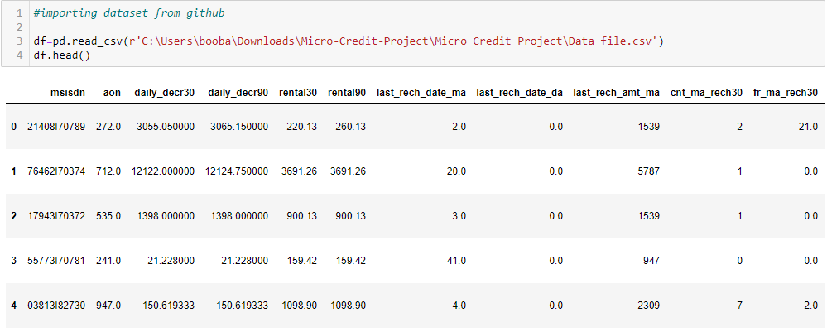
Data STRUCTURE

Slide 4
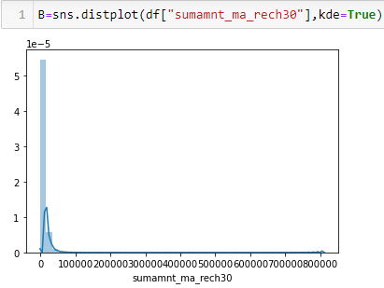
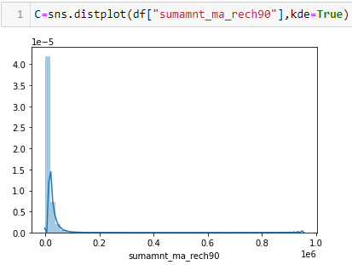
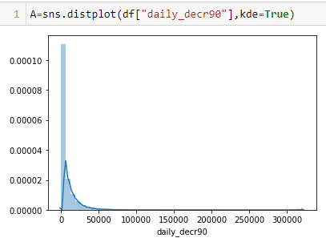
DATA VISUALIZATION

Slide 5
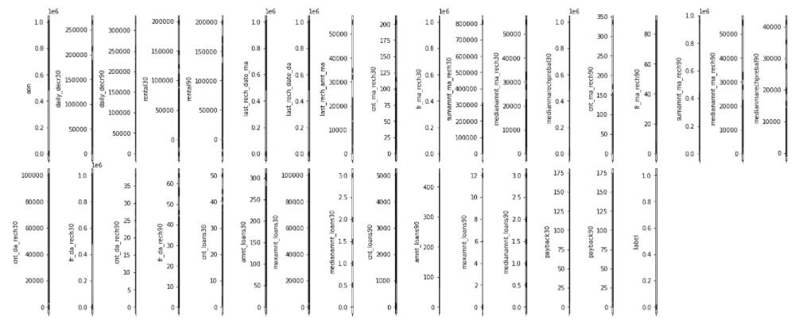
Outlier in DATA

Slide 6
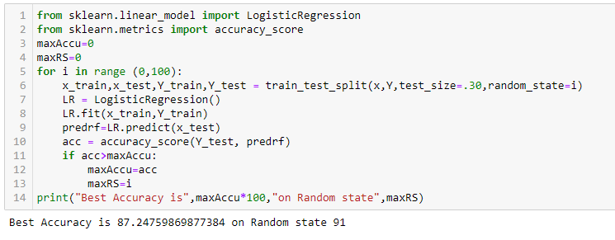
MODEL BUILDING
WE have identified this data is classification type. Hence I applied the Logistic Regression algorithm,

Slide 7

Test & Train Creation
Based on the score – we can create a train and test dataset to build a model.

Slide 8
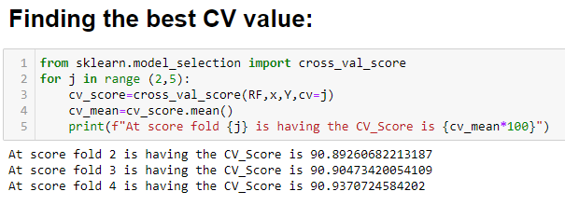
BEST CV -Value
I have created a code to find best CV value for this model – To validating the score which will help us to build a model in right way.

Slide 9
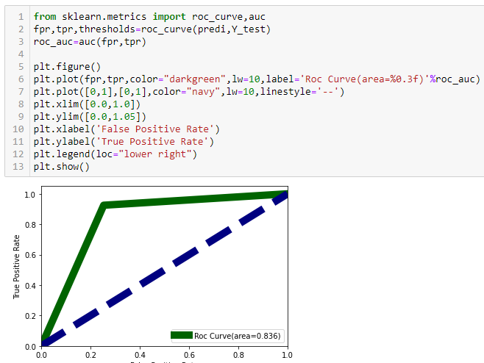
ROC CURVE

Slide 10
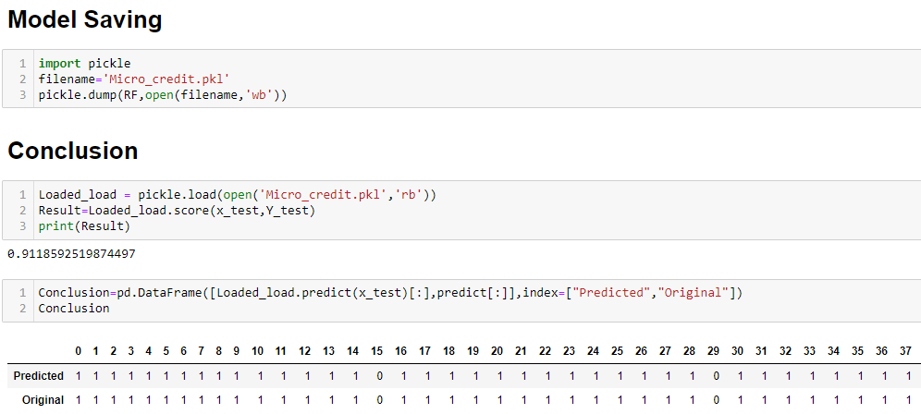
MODEL Saving

Slide 11
conclusion
Model final accuracy score is 91% - Visualization help me to understand the data and type. I performed the EDA which is outlier removal, skewness removal and standard scaling because it will help me to build model with high level accuracy.
Then I choose few algorithm to train my model which are :
Logistic Regression, Decision Tree & Random Forest. Hence, I am getting a final score is 91%.

